Slide 1
Profiling and analyzing GraphSaint with MH-Aug
20230503
박현우

Slide 2
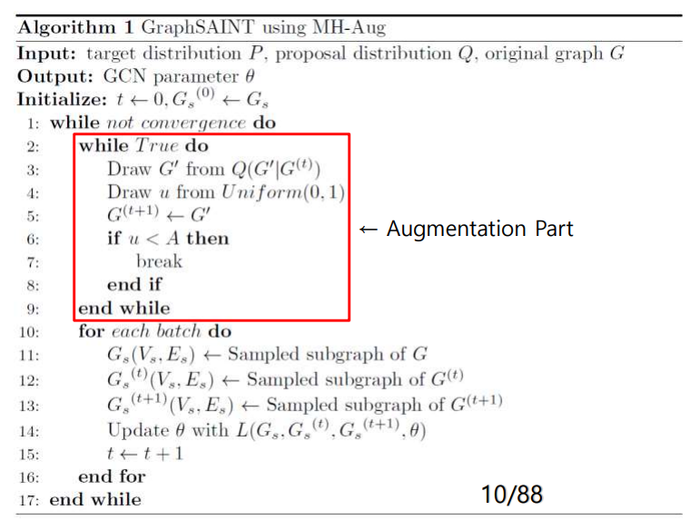
Training is very slow and as a result, the model doesn’t converge well.
= Are there any bottlenecks?
Run profiling in training of one sample graph in the dataset.

Slide 3
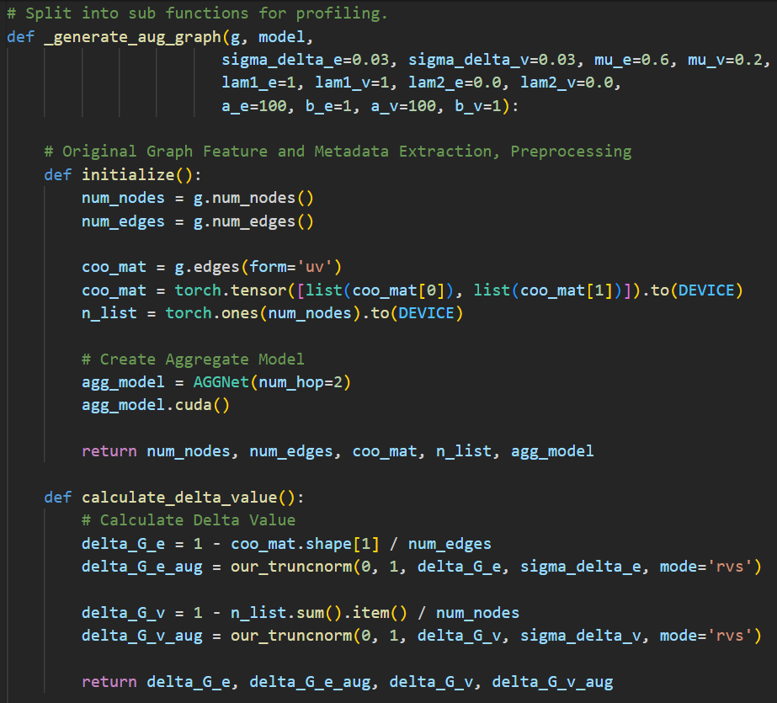
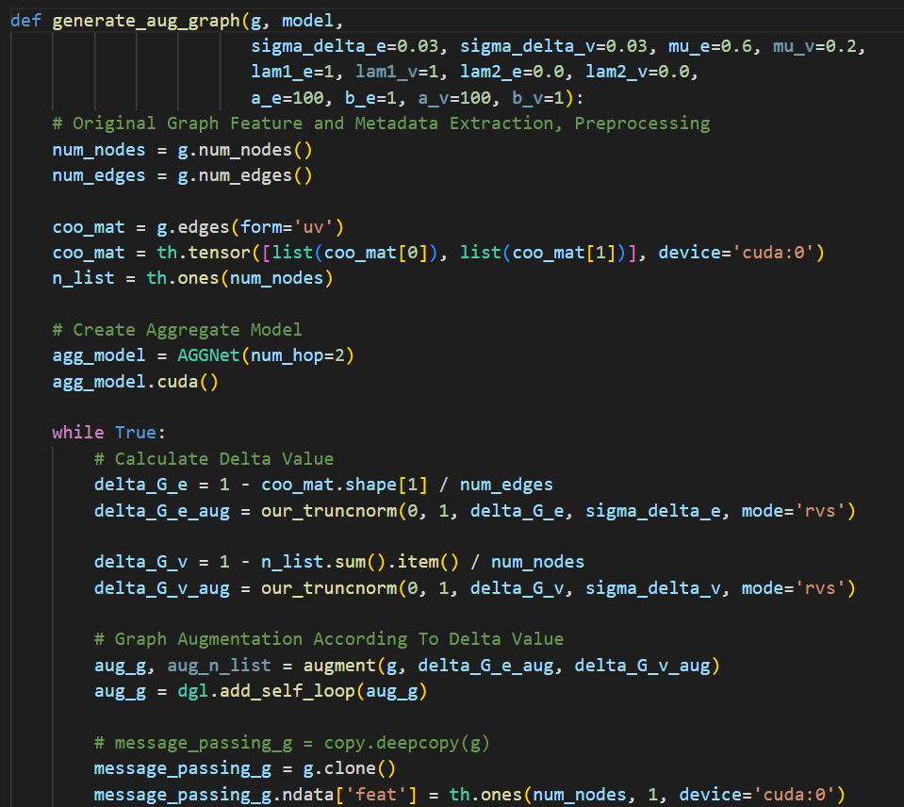

Slide 4
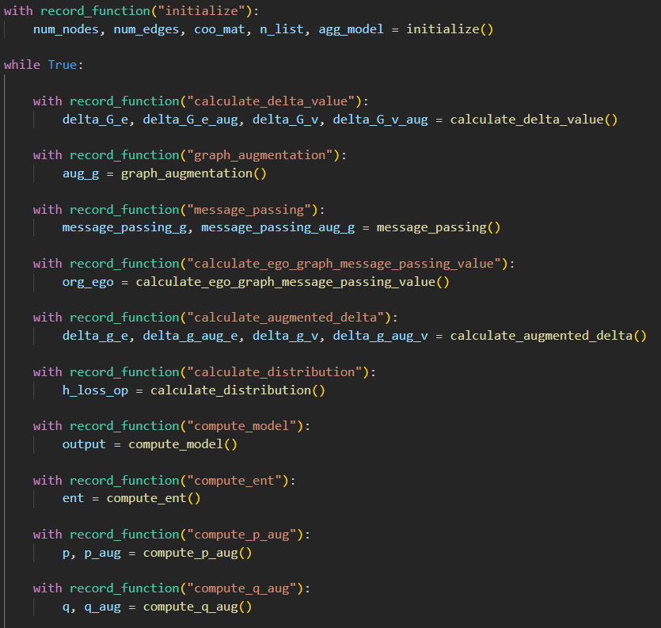

Slide 5
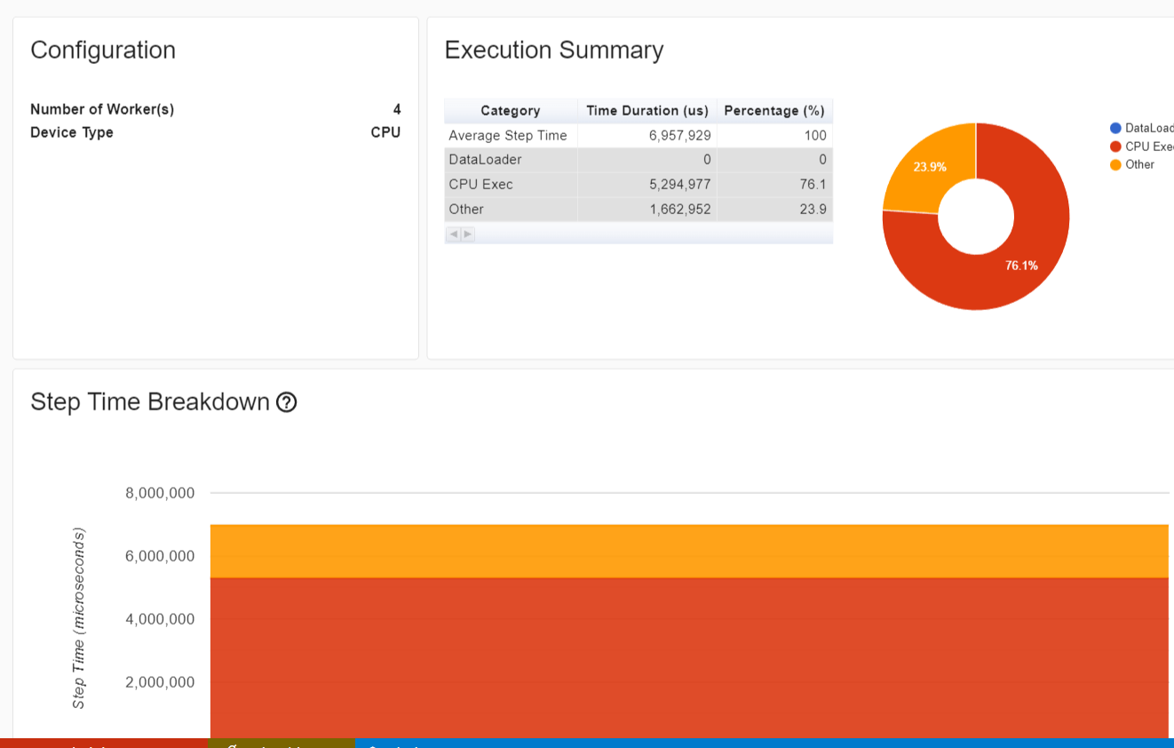

Slide 6
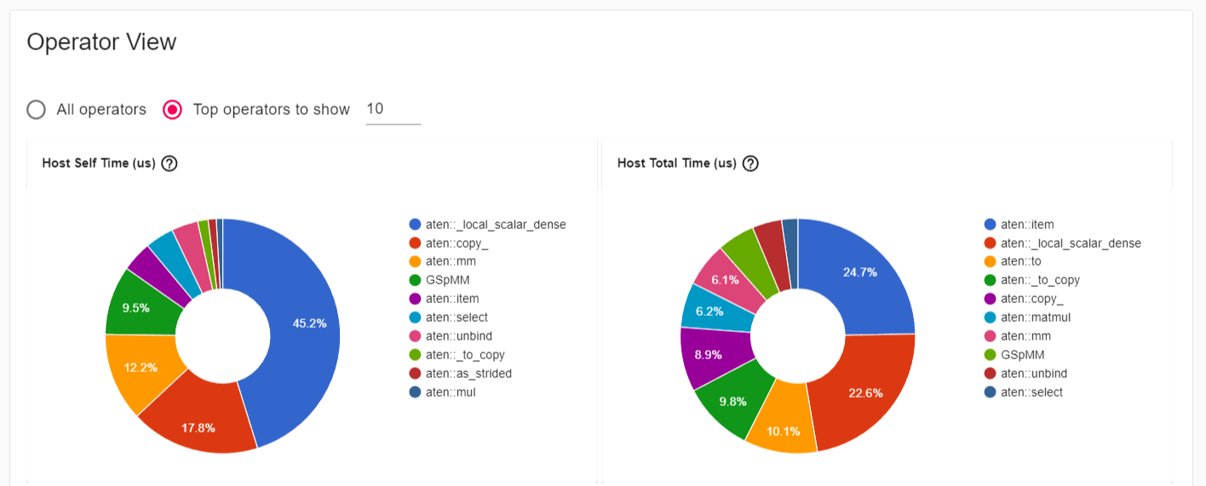
(left) Host Self Time
: Accumulated time of operator itself only.
(right) Host Total Time
: Accumulated time of both operator and its all children operators.

Slide 7
(left) / (right 2)
aten::_local_scalar_dense
Dense operation
(right) aten::item
Ordered_dict for parameter_dict, containing and handling parameters.

Slide 8
(left) aten::copy_
Copy from device memory into host memory
(right) aten::to
Move memory to other memory (H2D or D2H)
(right) aten::_to_copy
Copy from host memory into device memory

Slide 9
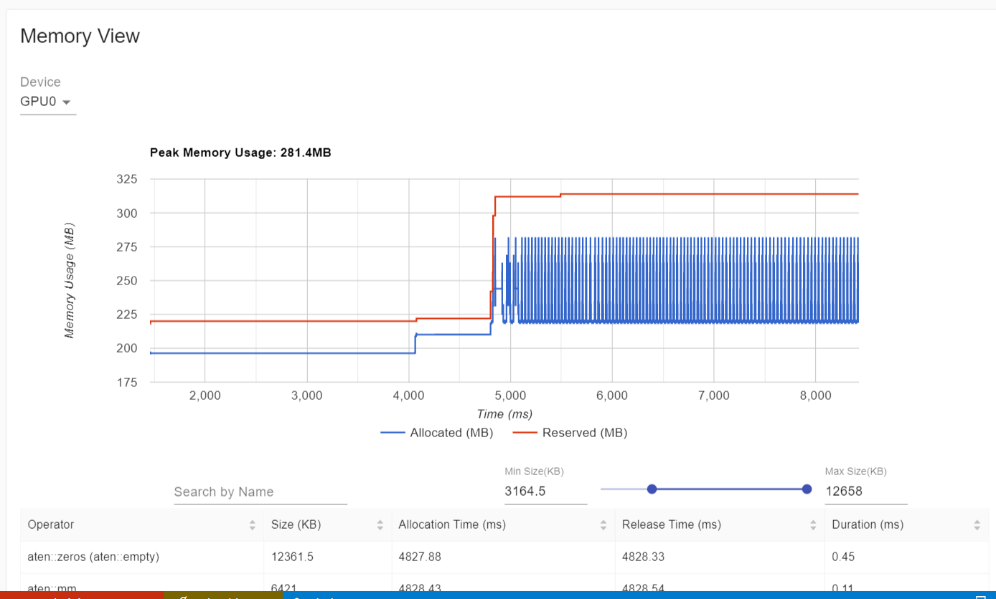
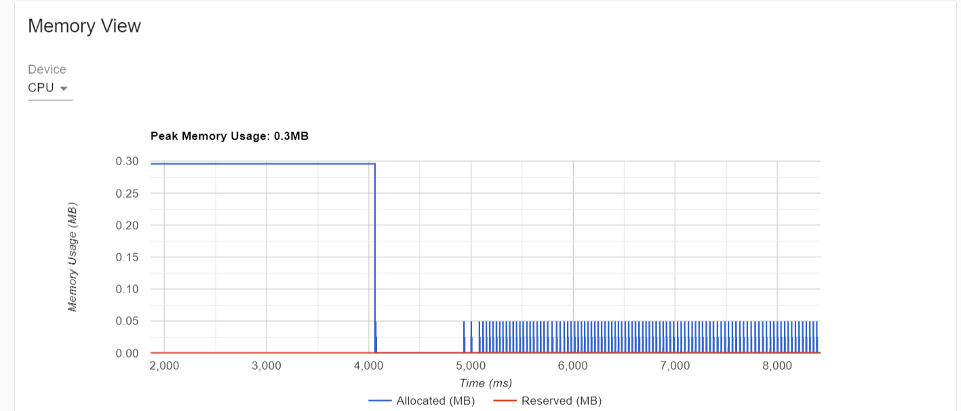
A lot of H2D and D2H copies

Slide 10
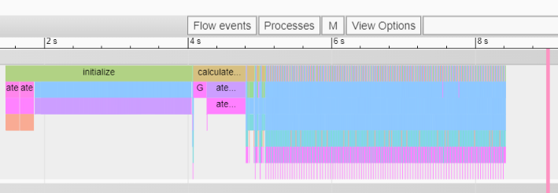
calculate_ego_graph_message_passing_value
Initialization
Augmentation loop

Slide 11
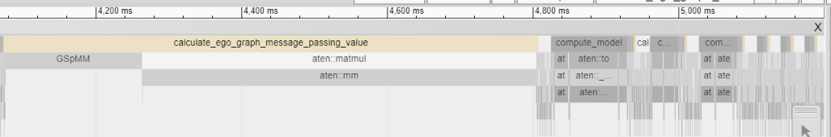
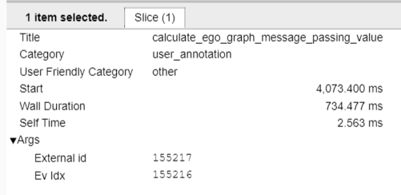
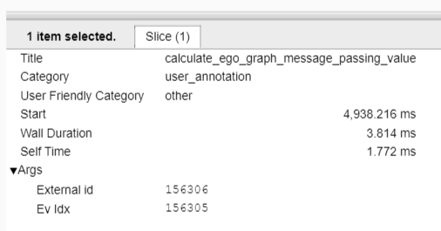
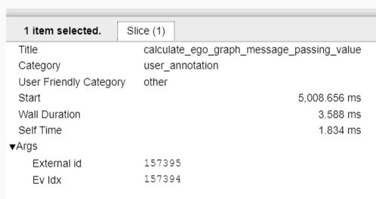
May be warming up? (= loaded on device and cached)

Slide 12
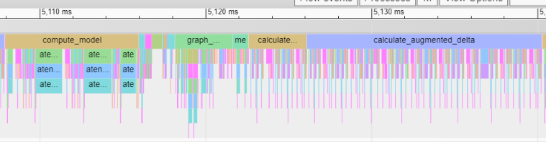
One cycle of augmentation loop
1. compute_model
2. graph_augmentation
4. calculate_augmented_delta
3. calculate_ego_graph_message_passing_value
Top 4 Time taken : 4 > 1 > 3 > 2

Slide 13
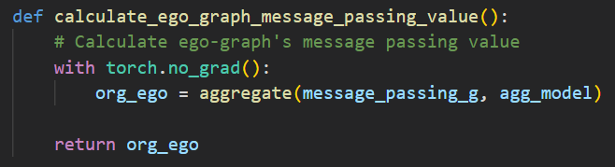
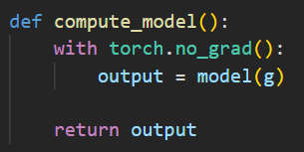
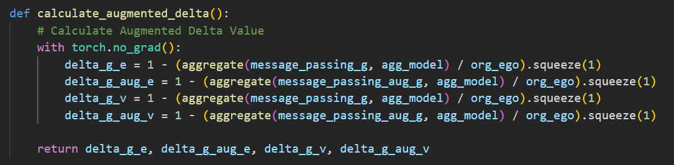
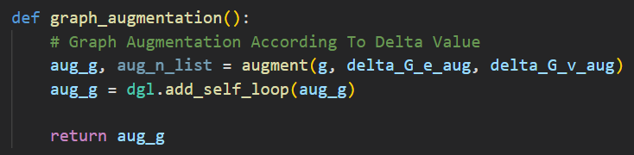
They use aggregate() function
= aggregate() is the bottleneck?

Slide 14
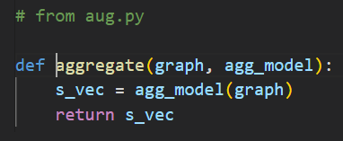
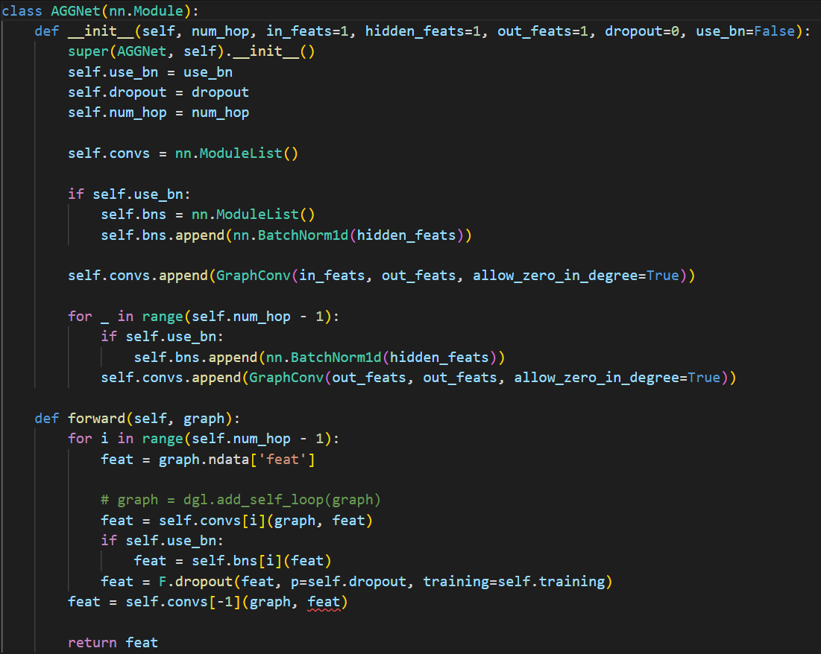
Future work #1
Optimize aggregate() function (= AGGNet)

Slide 15
Augmentation loop
= Inside the loop is repeated a lot of times

Slide 16
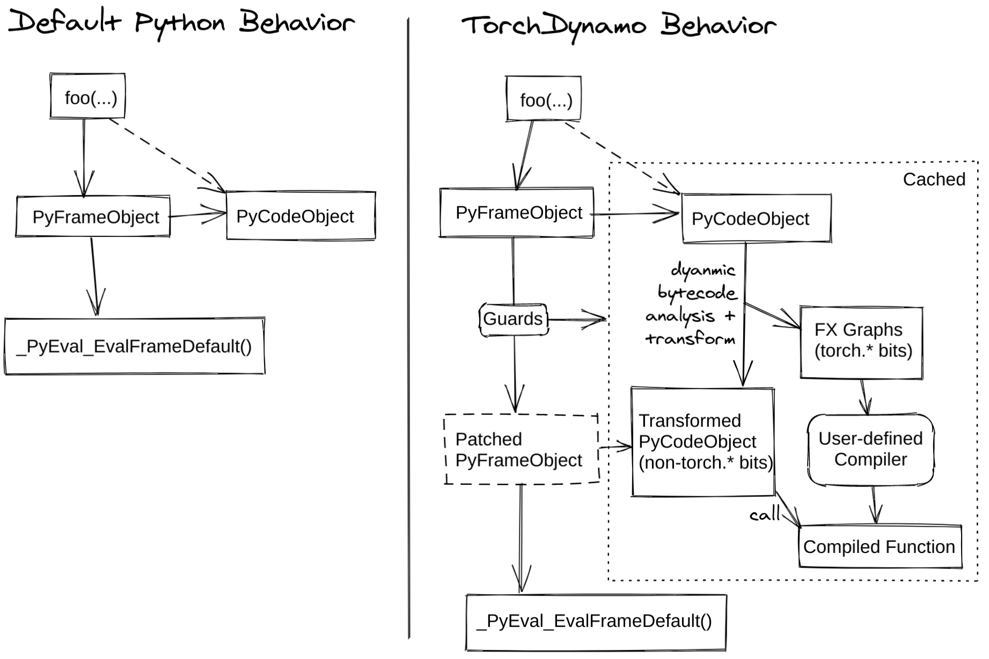
TorchDynamo (Torch Script)
TorchDynamo is a Python-level JIT compiler for accelerating PyTorch code.

Slide 17
TorchDynamo (Torch Script)
TorchDynamo dynamically modifies or “compiles” Python bytecode right before it is executed.
Then, it rewrites or “optimizes” Python bytecode in order to extract sequences of PyTorch operations.
Extracted PyTorch ops sequences are optimized, thus much faster than plain python codes or normal Pytorch code.

Slide 18
TorchDynamo
Furthermore, once compiled, these extracted PyTorch ops sequences are Cached.

Slide 19
Future work #2
Compile loop contexts.
NOTE : TorchDynamo is beta; unstable and only works for Plain python code and PyTorch - unable to apply to external libraries; e.g. DGL or Sci-py

